Slide 1
QAR87 AUD-EVK to Dev-Board
Daryl

Slide 2
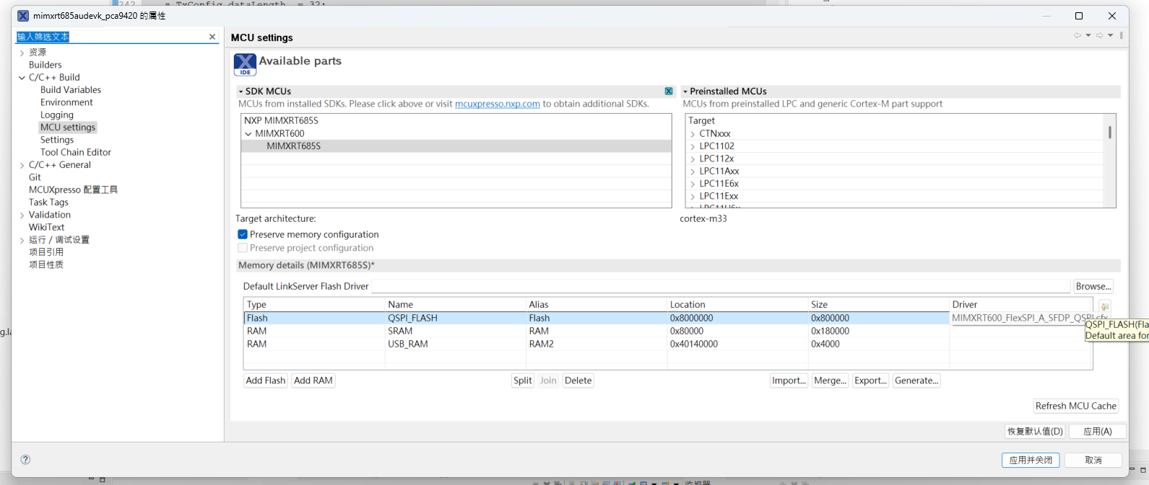
替換 ./flash_config/flash_config.c
專案點右鍵到 屬性->C/C++ Build->MCU settings -> [Flash] [QSPI FLASH] 從FlexSPI_B_SFDP_QSPI.cfx 改成 FlexSPI_A_SFDP_QSPI.cfx

